Slide 1

IST-736 Final Project
Building a Marvel Search Engine

Slide 2
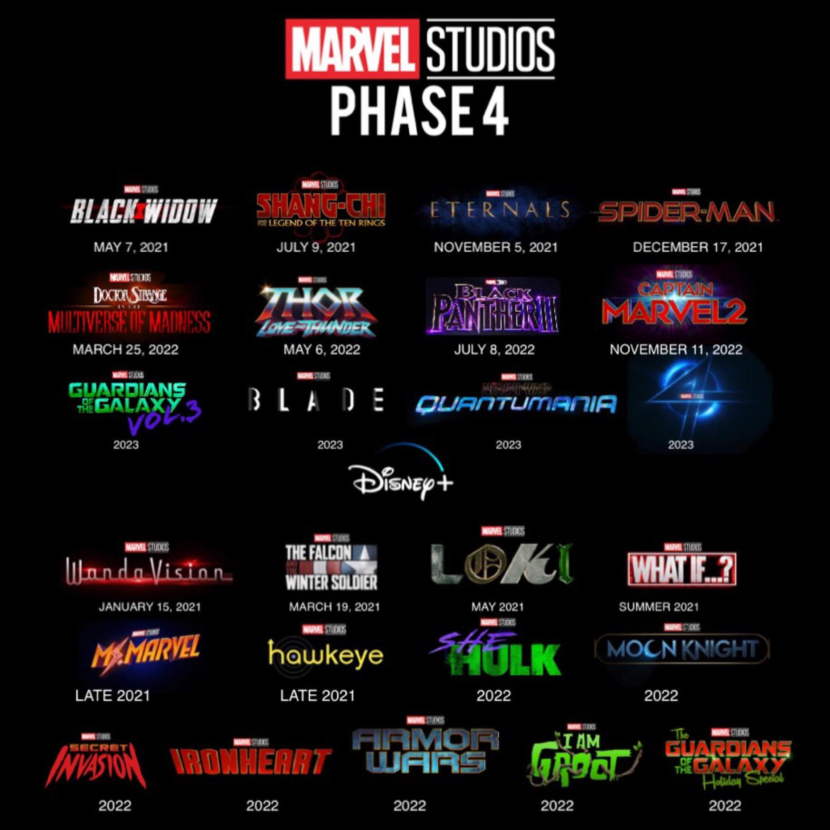
Marvel Cinematic Universe is getting too big
Problem Statement
The Infinity Saga (Phases 1-3) of the MCU, consisted of 23 movies which is would take more than 3000min to watch it all.
As Phase 4’s 25 TV shows and movies approach, how do we know which movies to pre-watch to get relevant information??

Slide 3


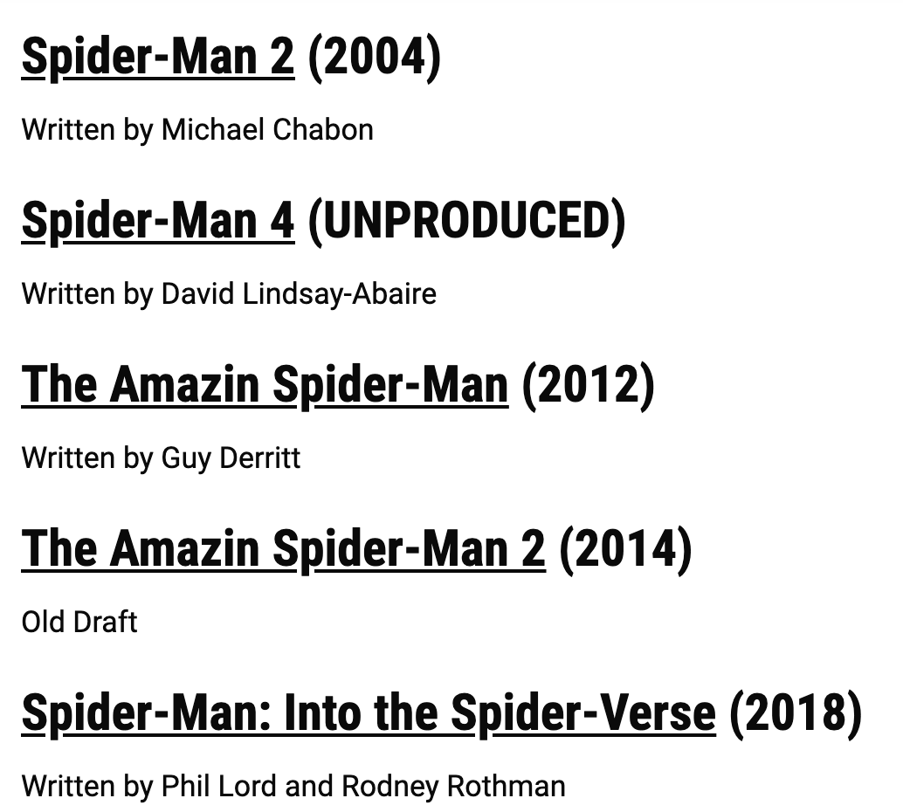
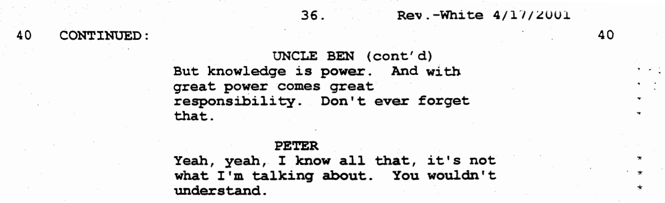
Finding Relevant MCU information through Movie Scripts
Proposed Solution
Build a model for a large text corpus of transcripts of Marvel movie screenplay – then using a search engine, given a query (like a dialogue, monologue, location or character) retrieve corresponding documents ranked in order of relevance.
The search engine will then help MCU fans, find a place in the MCU where they can learn more about a specific topic rather than rewatching all the movies.
Search Bar
With great power comes great responsibility
https://www.scriptslug.com/assets/scripts/spider-man-2002.pdf
Excerpt – Who said what..
Relevant Marvel movies

Slide 4
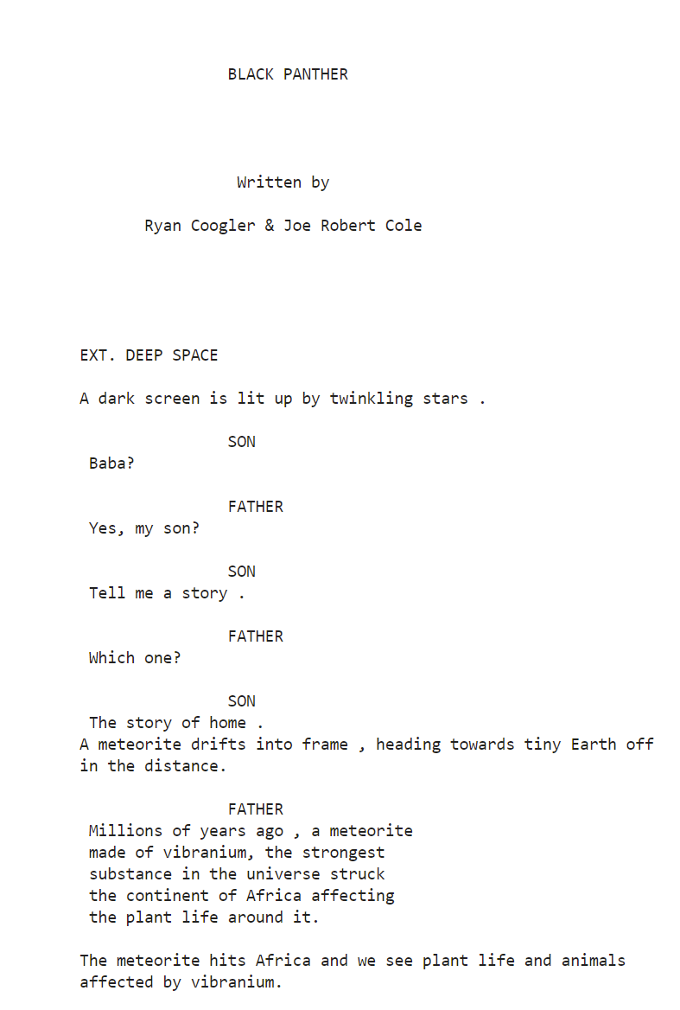
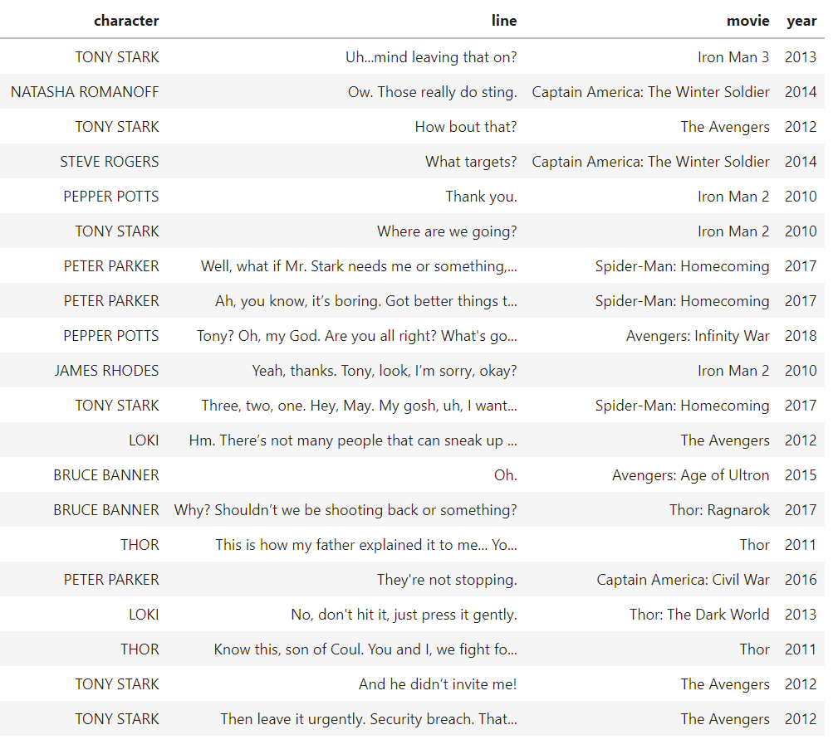
Finding Relevant MCU information through Movie Scripts
Text Mining Concepts
Scripts are not standardized. Scripts can come as pdfs or text files where each one might follow a different patter. Using text scraping and regex, the text should be standardized.
Raw Script PDF
Vectorized Script
Processing Script
Get important characters and their dialog.
Get setting and narration of script.
Remove un-important comments.
Clean up Text for modeling.

Slide 5
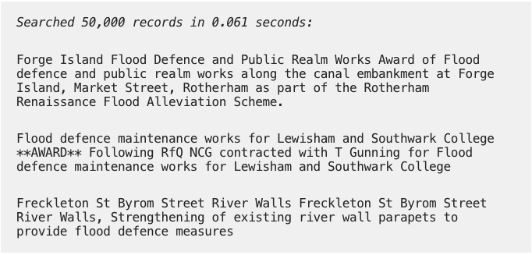
Search Pipeline
Data preparation
Build Model
Search in action!
Model - train/test data
Flood Defense
Obtain data-set
Screenplay of Marvel movies in transcript
Split data using k-fold cross-validation
Vs
Vs
Google’s universal-sentence-encoder
Naïve Bayes
B25
EDA + Clean/munge
Tokenize
Stem
Lemmatize
Vectorize
TF-IDF
TF-IDF on ‘steroids’ (BM25)

Slide 6
Current Status
Text Mining Concepts
Scripts are not standardized. Scripts can come as pdfs or text files where each one might follow a different patter. Using text scraping and regex, the text should be standardized.

Slide 7
References

